Slide 1
Oracle9i Application Server
PL/SQL网关配置及应用实例

Slide 2
PL/SQL开发 网关配置
PL/SQL网关工作过程

Slide 3
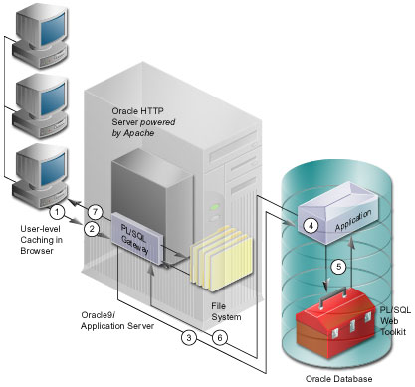
PL/SQL:mod_plsql 原理
PL/SQL插件工作过程

Slide 4
PL/SQL开发 网关配置
加载PL/SQL程序支持包

Slide 5
PL/SQL开发 网关配置
安装PL/SQL支持程序包
加载程序包：
$ORACLE_HOME/iSuites/Apache/modplsql/owa/owaload.sql

Slide 6
PL/SQL开发 网关配置
配置DAD(Data Access Description)

Slide 7
DAD配置：设置配置文件
# httpd.conf ($ORACLE_HOME/iSuites/Apache/Apache/conf/httpd.conf)
# |
# |== oracle_apache.conf ($ORACLE_HOME/iSuites/Apache/Apache/conf)
# |
# |
# |== plsql.conf ($ORACLE_HOME/iSuites/Apache/modplsql/cfg)
DAD配置文件：$ORACLE_HOME$/Apache/modplsql/cfg/wdbsvr.app

Slide 8
DAD配置:配置文件实例
# -----------------------------------------------------------------------------------------------------------------------
# A typical PLSQL application DAD
# ------------------------------------------------------------------------------------------------------------------------
[DAD_scott]
connect_string = sun4500:1521:ora8i
password = tiger
username = scott
default_page = p_test
document_table = sample.wwdoc_document
document_path = docs
document_proc = sample.wwdoc_process.process_download
upload_as_long_raw =
upload_as_blob = *
reuse = Yes
connmax = 10
enablesso = no
pathalias = url
pathaliasproc = sample.wwpth_api_alias.process_download

Slide 9
PL/SQL开发 网关配置
配置步骤:
连接数据库，测试DAD配置

Slide 10
使用PL/SQL开发数据驱动Web页面
Create or Replace Procedure P_Test AS
ignore boolean;
BEGIN
htp.htmlopen;
htp.headopen;
htp.headclose;
htp.bodyopen;
htp.header(1, ' 输出数据库基表中数据');
ignore := owa_util.tableprint('emp','BORDER',owa_util.html_table);
htp.bodyclose;
htp.htmlclose;
END;

Slide 11
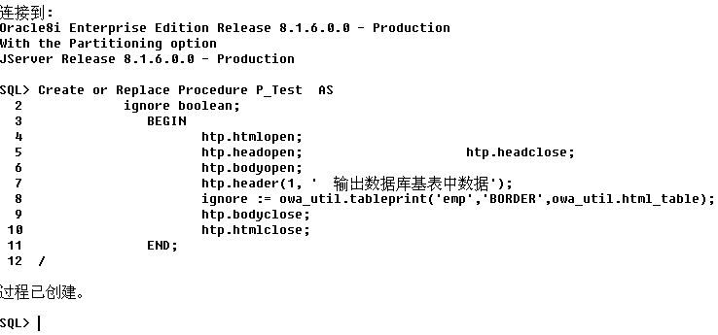
使用PL/SQL开发数据驱动Web页面

Slide 12
显示数据库中的基表信息
http://166.111.7.1/pls/scott/p_test

Slide 13
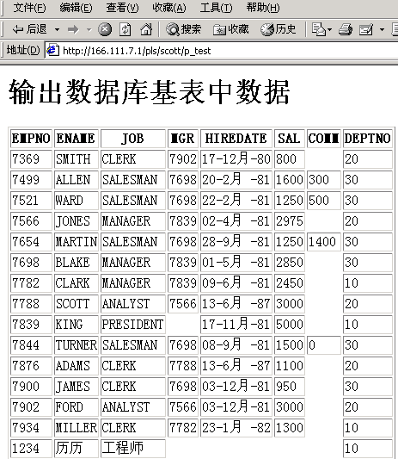
显示数据库中的基表信息

